Slide 1

Smart On-Street Parking
Made by:
Vladut PANAITE 1111154
Adrien COSTANDI 1110995

Slide 2
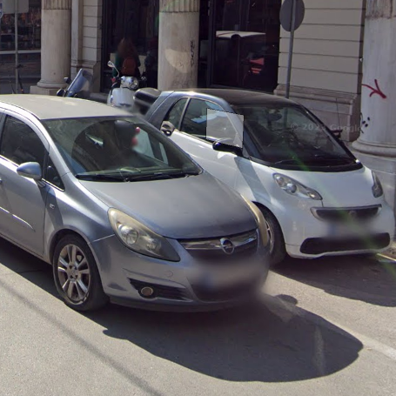
Problems
Traffic congestion
Road obstructions
Limited space for parking
High costs for hiring officers to maintain order in streets patrol
Difficulties finding parking spots
Blocked facilities like garages, hydrants, crosswalk etc.

Slide 3

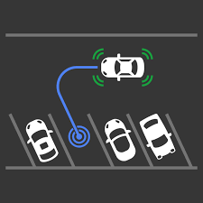
Our Solutions
Using cameras and AI
Detect illegal on street parking
Manage law enforcers efficiently by setting priorities for illegal parking

Slide 4

Stakeholders :
Cities / Municipalities
Traffic law enforcements
Citizens
Public Administration
Parking management companies

Slide 5
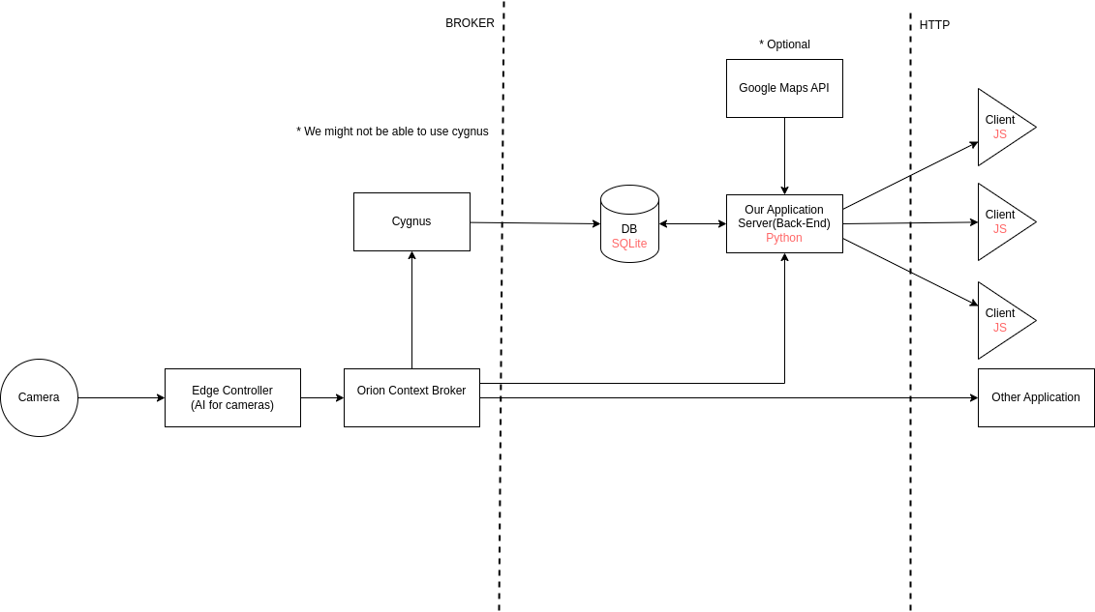
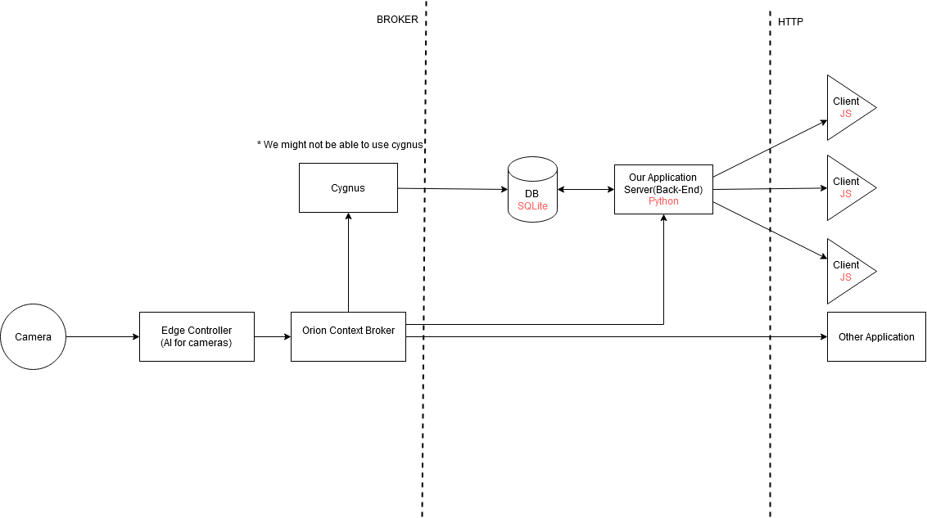
Architecture

Slide 6
Requirements
Database to store context information from context broker
Rest API for Client Application
Data transfer from Edge Controller to Context Broker
Client Application

Slide 7
Implementation Steps
Retrieving & process data from camera using AI
Setting up the Orion Context Broker and Cygnus
Implementation of the Rest API (back-end)
Implementation of the Client Application (front-end)
Testing with fake data input

Slide 8
Features
Detection of illegal parking
Notify law enforcers about illegal parking around the city
Offering suggestion about available parking spots
Offering statistics to the municipality about the most crowded streets
Using google API to detect if illegal parking has an impact to the trafic
= Completed
= Optional

Slide 9
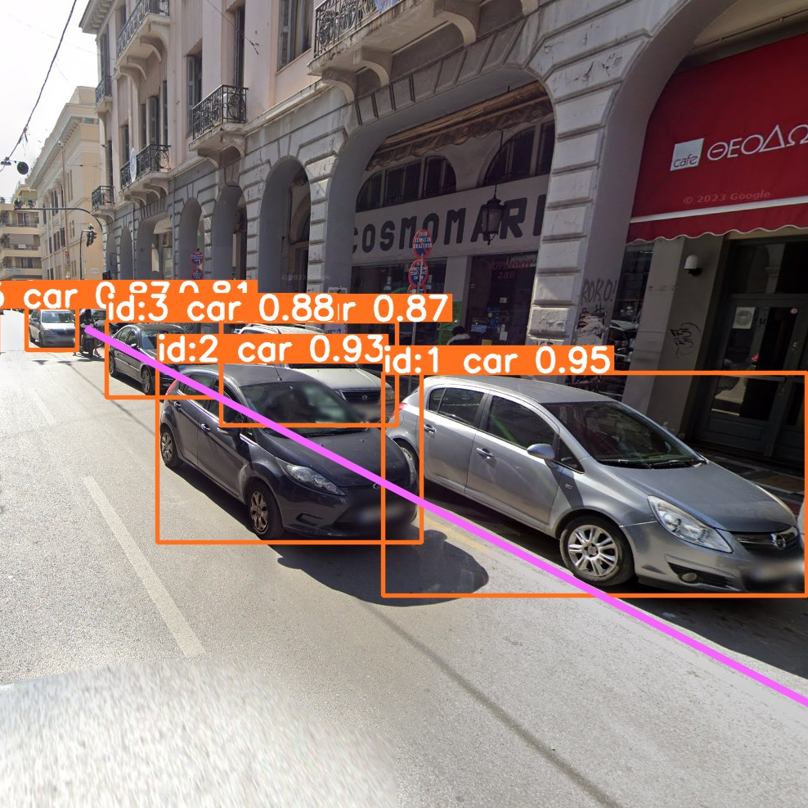
AI
Every 10s the AI will process the image received from the camera and will determine if someone is illegal parked or not
The AI (uses Yolov8) will detect the cars and it will check if a car stays outside the area used for parking (marked by the pink line) for some amount of time. When that condition is met it will send an update to the Context Broker.

Slide 10
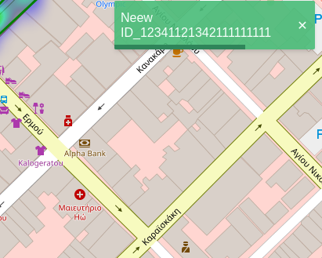
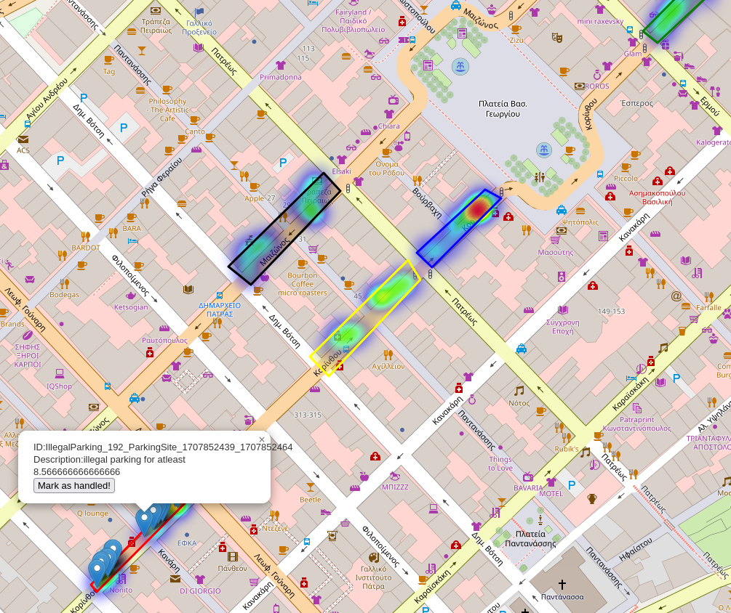
Features
Live icons
Heat map
Notifications

Slide 11
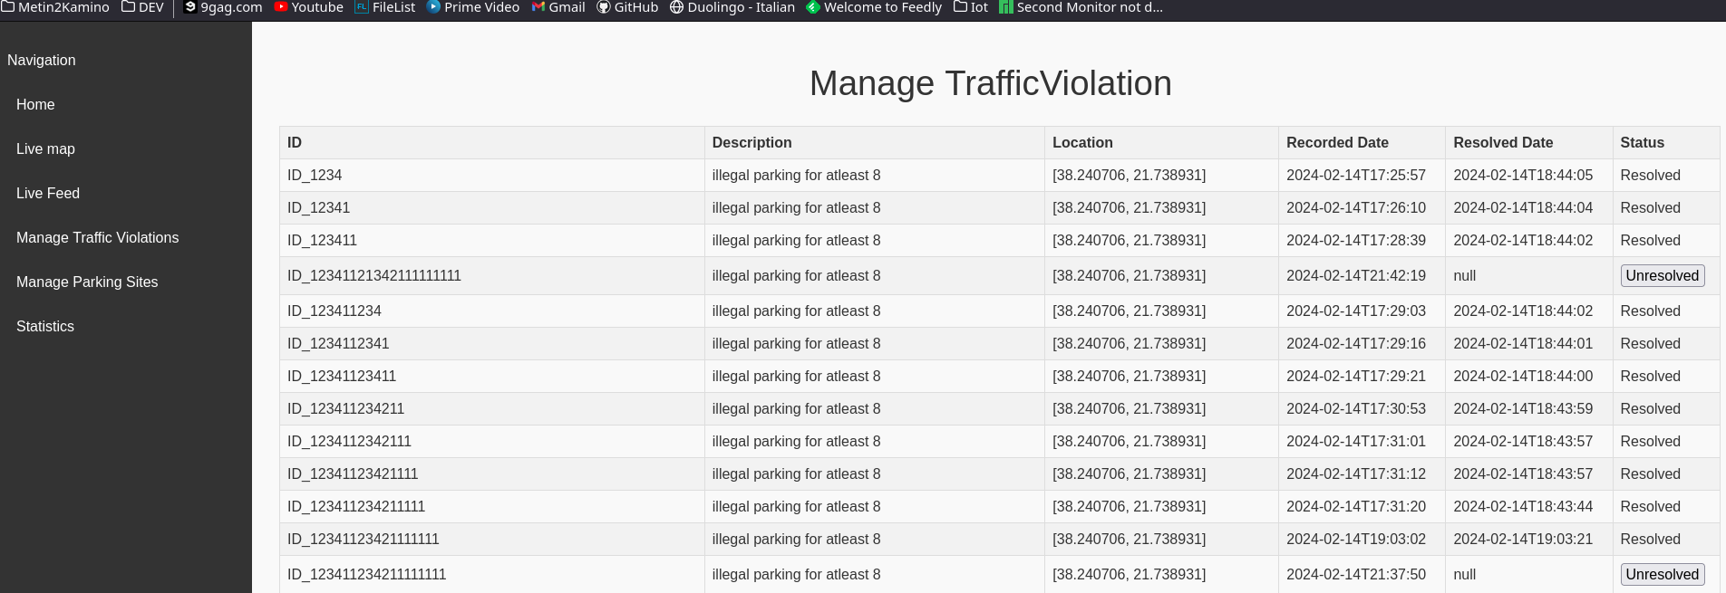
Features

Slide 12
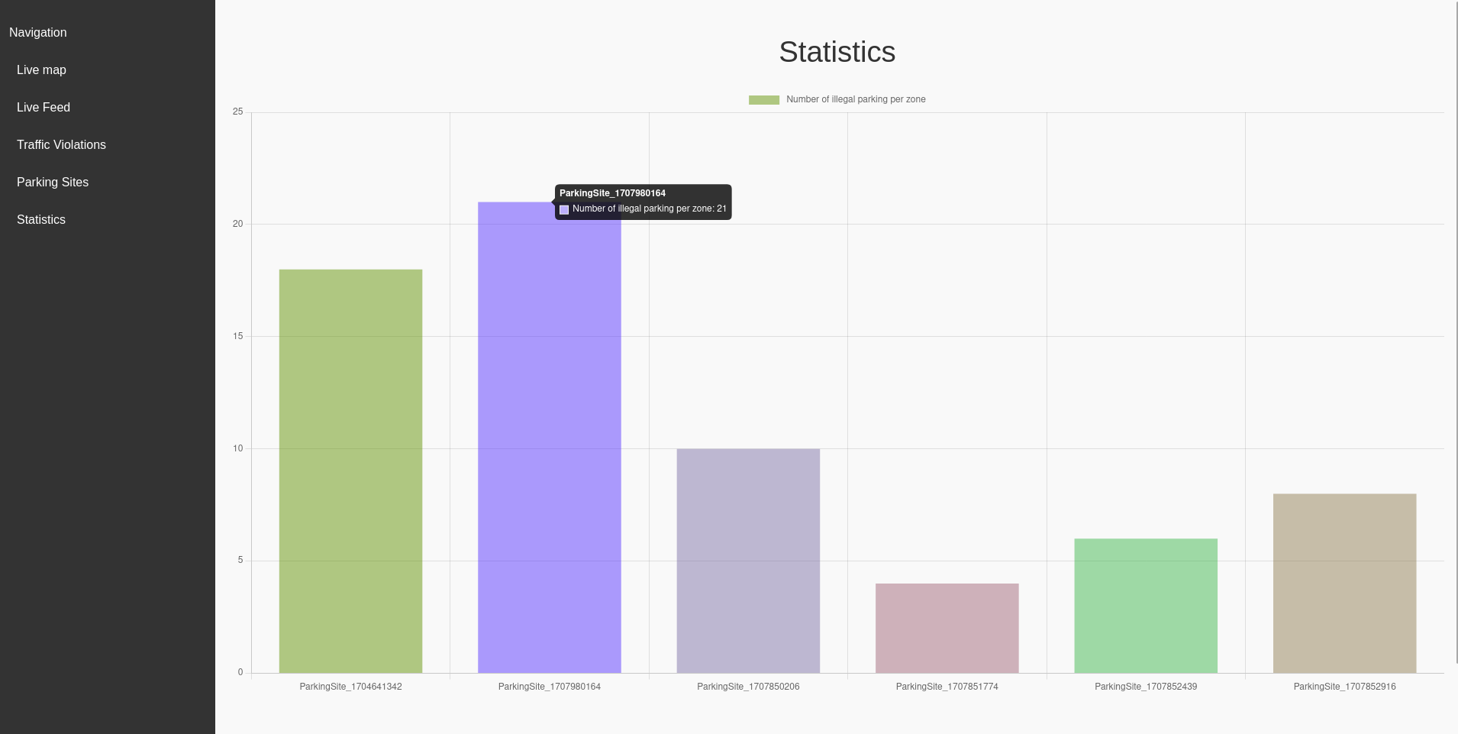
Features

Slide 13
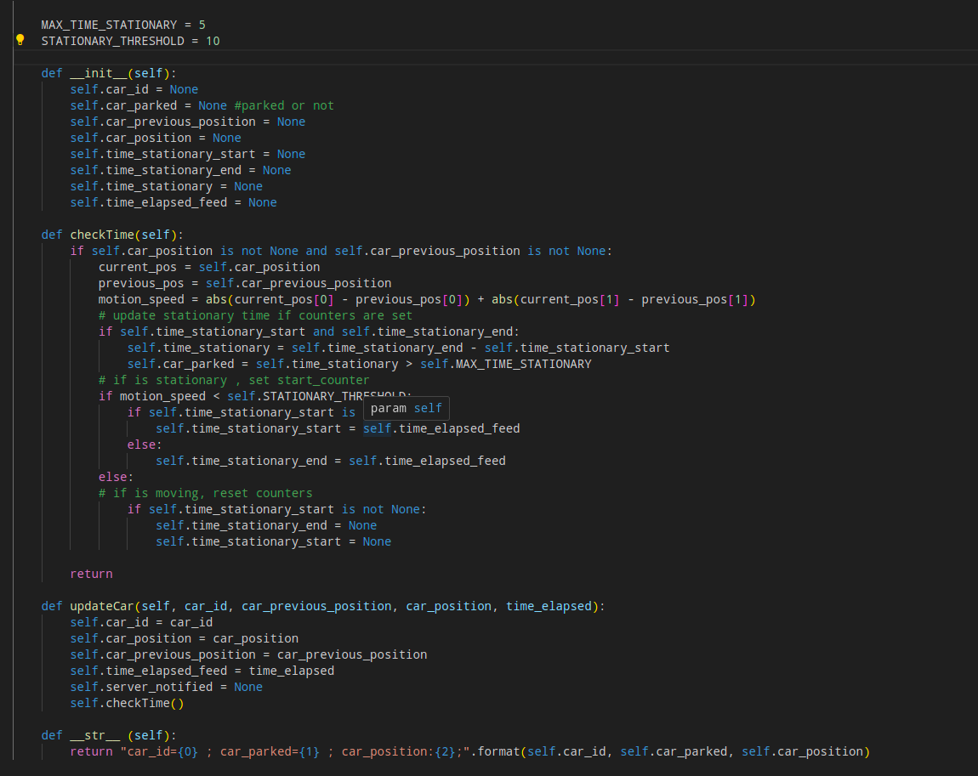
AI code
AI checks if a car is stationary for more than 5 seconds

Slide 14
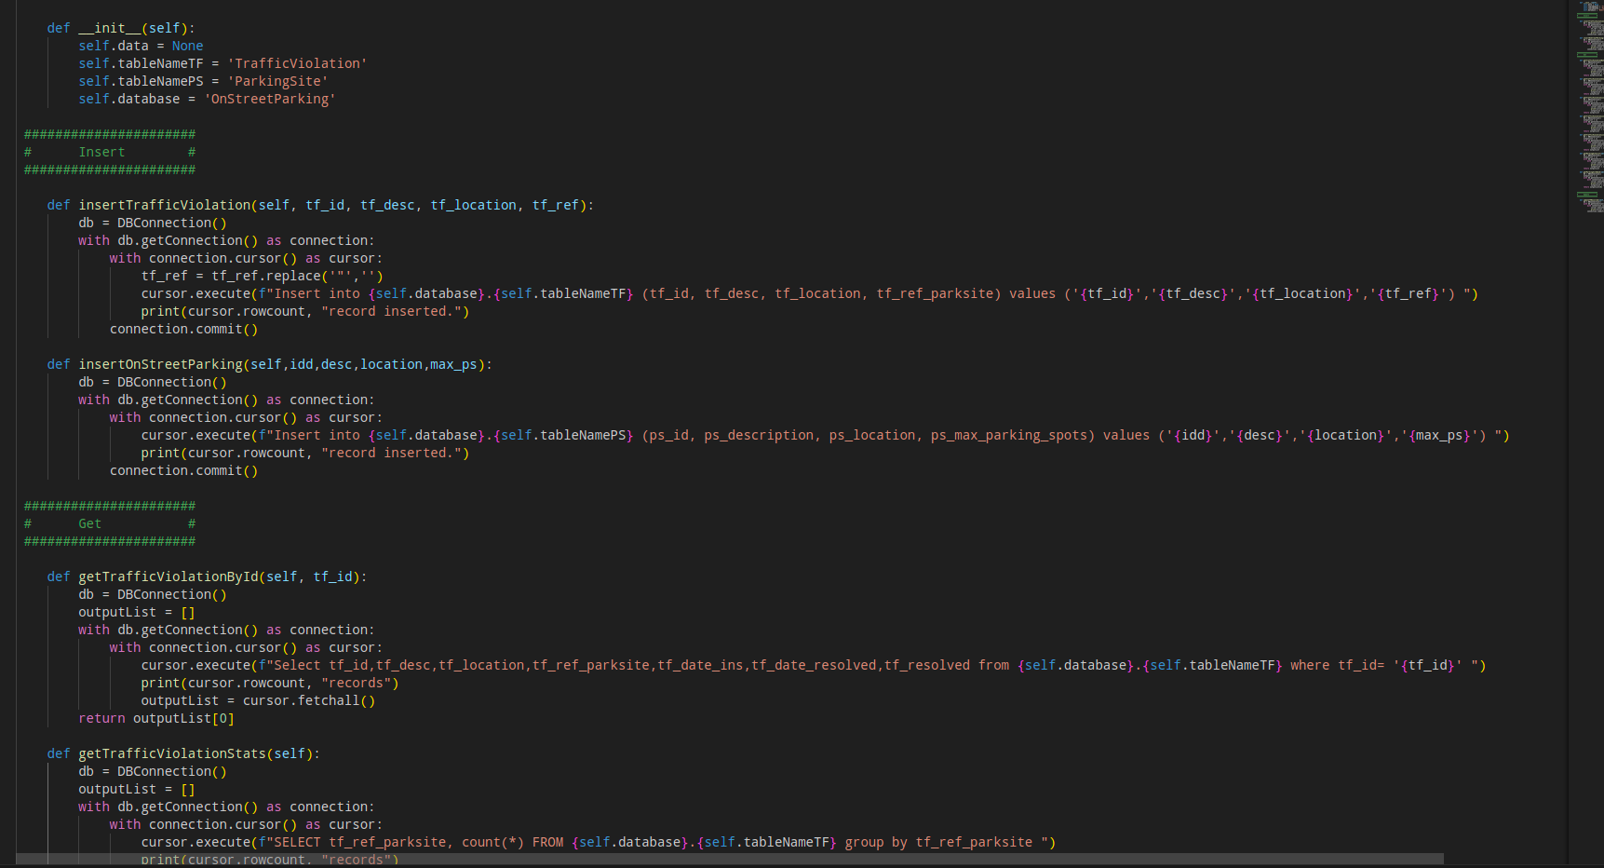
Database code

Slide 15
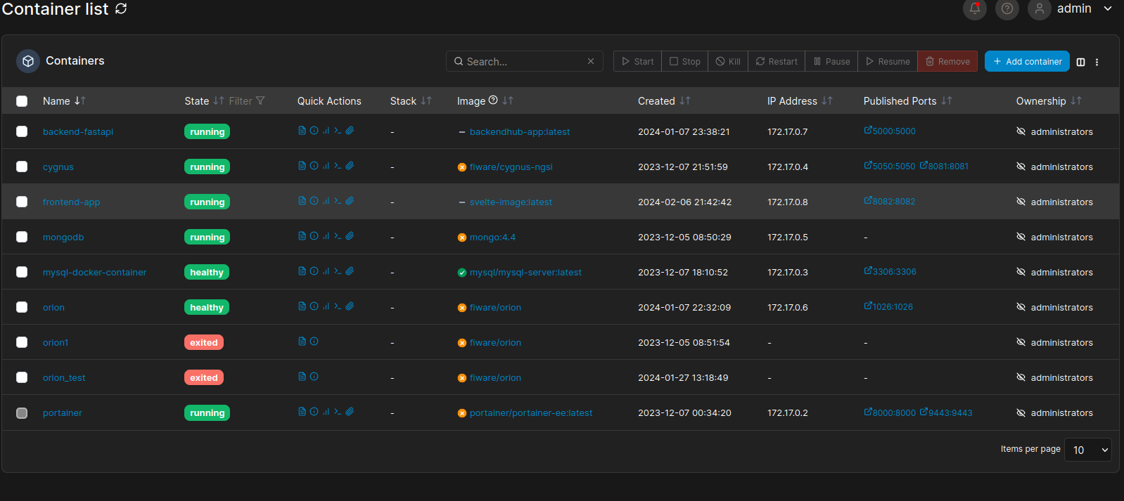
Containers

Slide 16
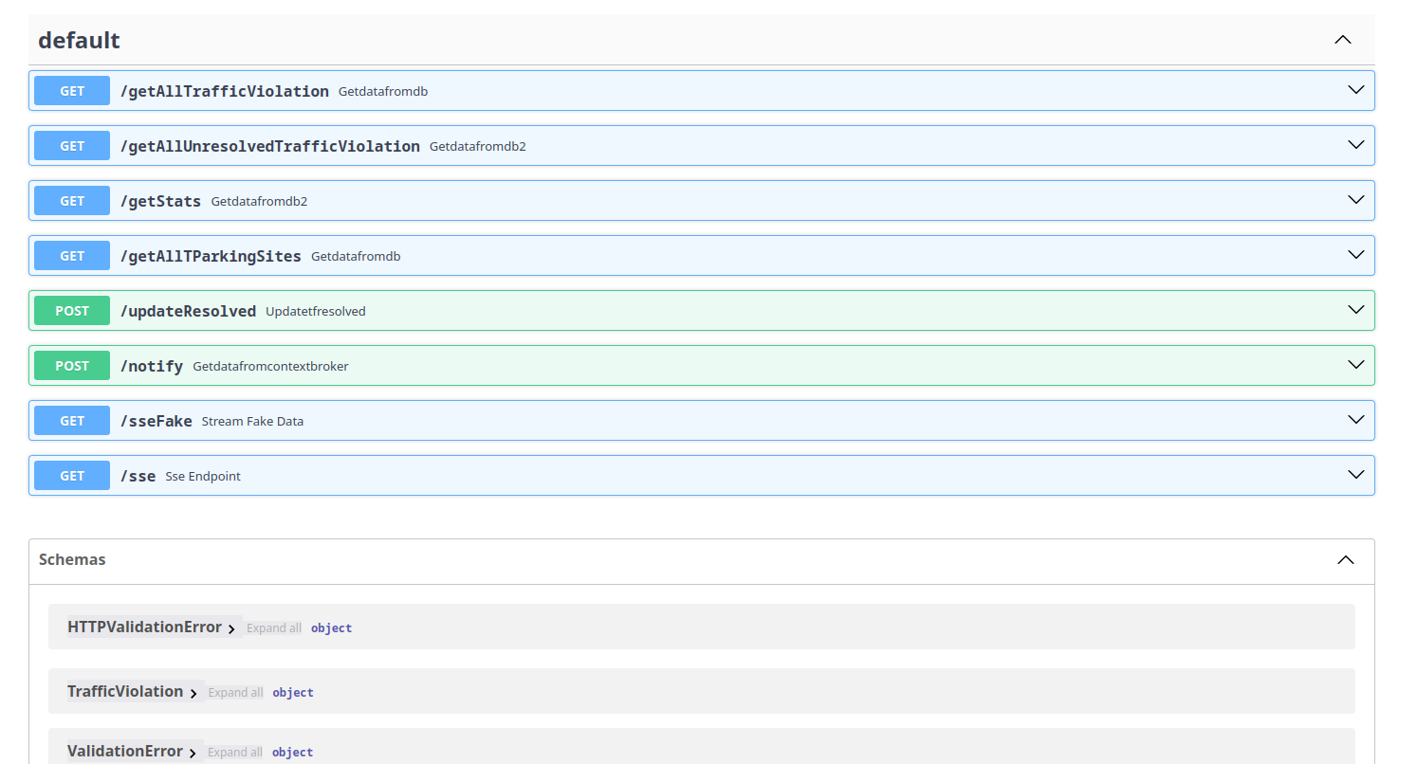
API endpoints

Slide 17

DEMO TIME !
Notes:
AI running
Live markers
Remove markers
Notifications when new marker appears
Heatmap
Live video
Statistics (maybe ?)
Manage traffic violations
Parking sites (area and description + parking spots)
Using smart datamodels

Slide 18
Division of Work
Vlad - Retrieving & process data from camera using AI
Both - Setting up the Orion Context Broker and Cygnus
Both - Implementation of the Rest API (back-end)
Adrien - Implementation of the Client Application (front-end)
Vlad- Testing with fake data input

Slide 19
Improvements
Have another app that lets the user determine where the legal parking areas are by drawing on the map
We could also connect to the city's database to retrieve their informations about parking areas and use them

Slide 20
Thank you for listening !
Any questions ?

